Slide 1



Workshop Series: Reusable Research Data Made Shiny
Welcome Back!
Session 1
Session 2
Session 3
Session 4
Wrap-up!
Ontario Dairy Research Centre | Online
February 21st - 24th, 2023

Slide 2
Quick Posit Cloud Recap (RStudio Cloud)
Welcome Back!
Session 1
Session 2
Session 3
Session 4
Wrap-up!

Slide 3
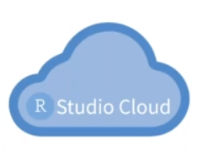
Posit Cloud Recap
Welcome Back!
Session 1
Session 2
Session 3
Session 4
Wrap-up!
What is Posit cloud?
R Studio IDE in the cloud!
Using server hosted on the internet rather than a
local computer or server

Slide 4
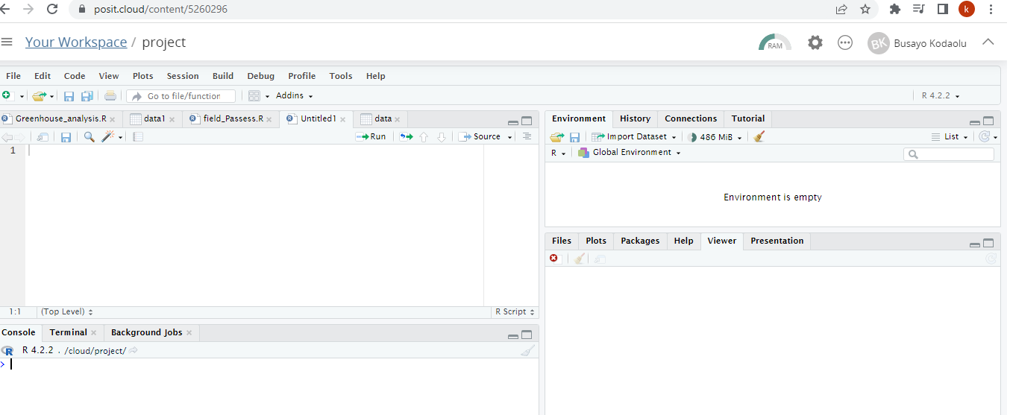
Posit Cloud Recap
Welcome Back!
Session 1
Session 2
Session 3
Session 4
Wrap-up!
Start coding directly from your browser!

Slide 5
Welcome Back!
Session 1
Session 2
Session 3
Session 4
Wrap-up!
Posit cloud set-up
Work along (if you haven't activated RStudio)
Remember to use your stickers to indicate your progress/you need help

Slide 6
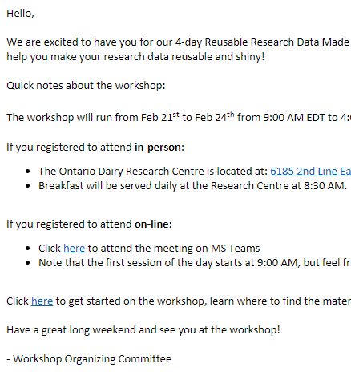
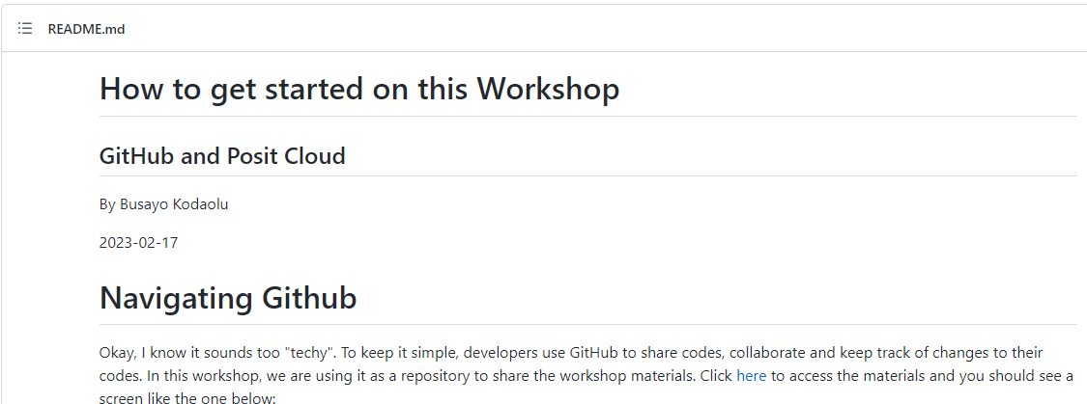
Welcome email
Welcome Back!
Session 1
Session 2
Session 3
Session 4
Wrap-up!
You should have received a welcome email
Instructions on how to download workshop materials and setup the free Posit Cloud account
Workshop GitHub page

Slide 7
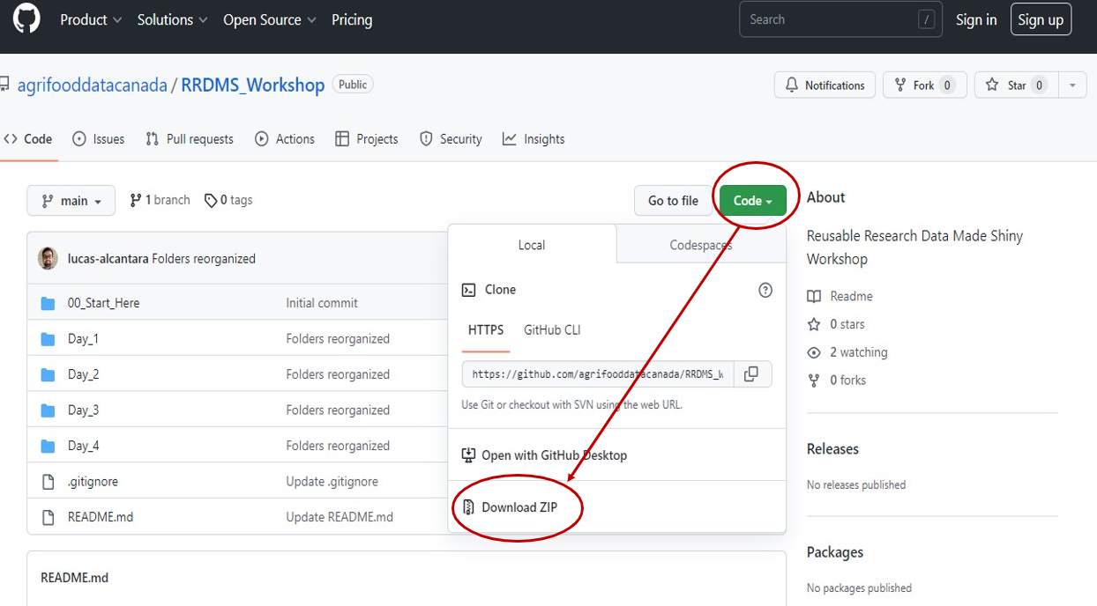
Downloading workshop materials
Welcome Back!
Session 1
Session 2
Session 3
Session 4
Wrap-up!

Slide 8
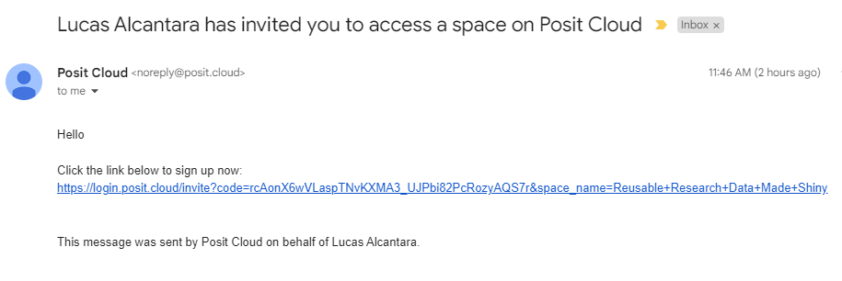
Posit cloud set-up --> Invitation email
Welcome Back!
Session 1
Session 2
Session 3
Session 4
Wrap-up!
Email inviting you into the workshop space
Click

Slide 9
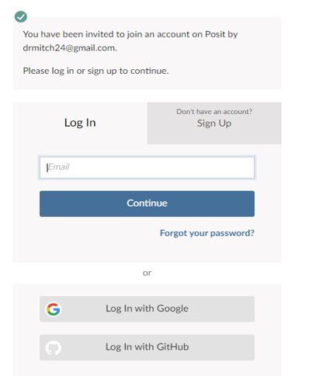
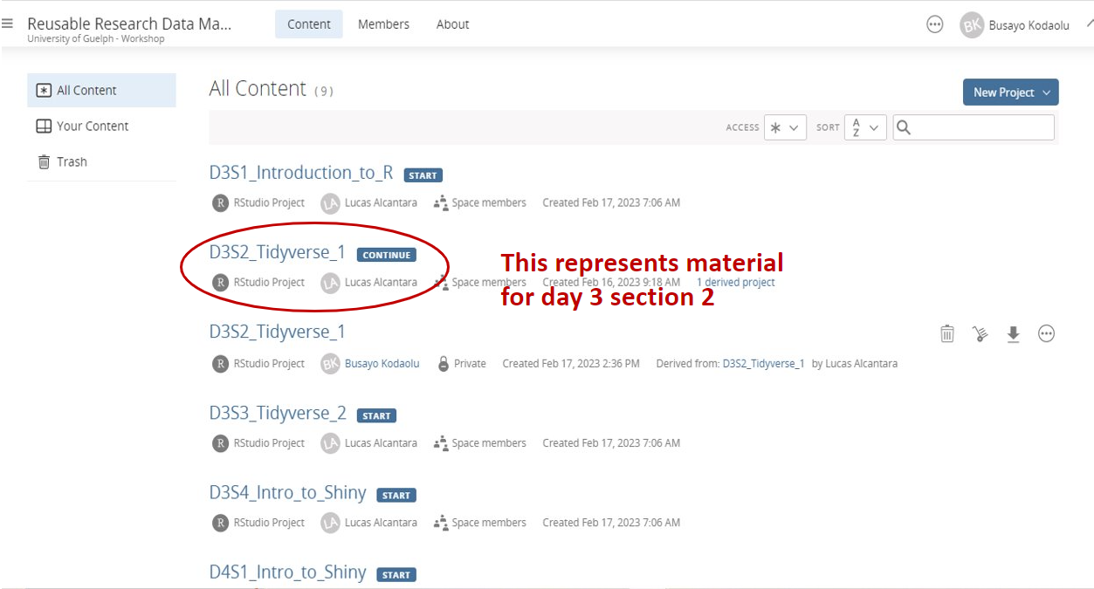
Log In or Sign Up
Welcome Back!
Session 1
Session 2
Session 3
Session 4
Wrap-up!

Slide 10
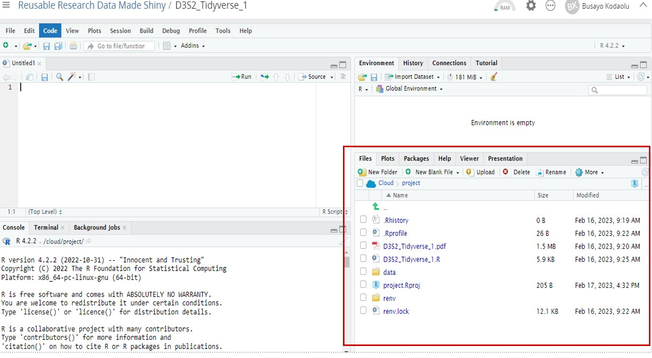
D3S2_Project files preloaded
Welcome Back!
Session 1
Session 2
Session 3
Session 4
Wrap-up!

Slide 11
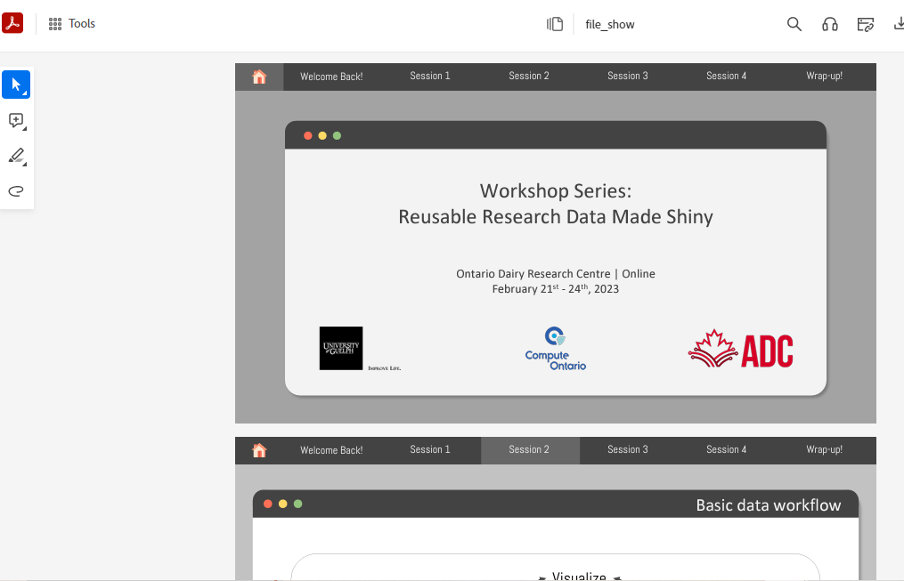
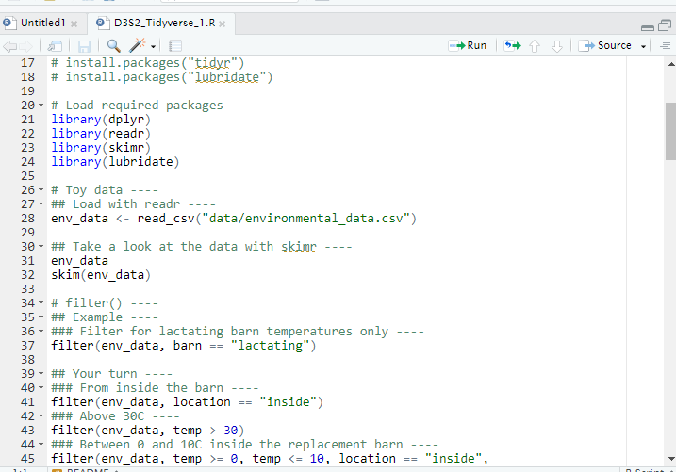
Slides and R-script for that section
Welcome Back!
Session 1
Session 2
Session 3
Session 4
Wrap-up!

Slide 12


Workspaces?
Welcome Back!
Session 1
Session 2
Session 3
Session 4
Wrap-up!
Shared workspace/classroom
Personal workspace/office
Both can be made public or private

Slide 13
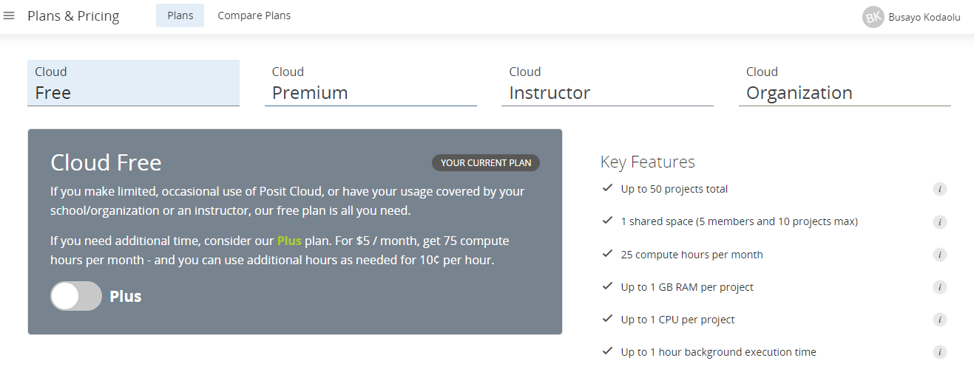
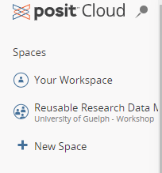
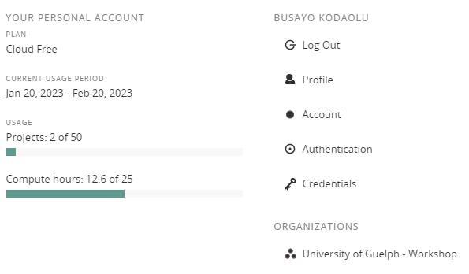
Your workspaces?
Welcome Back!
Session 1
Session 2
Session 3
Session 4
Wrap-up!
Click here
2 accounts
(Can create more but there is limit for the free account)

Slide 14
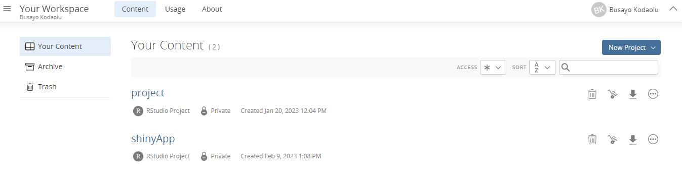
Your workspaces?
Welcome Back!
Session 1
Session 2
Session 3
Session 4
Wrap-up!
Click here to start a project

Slide 15
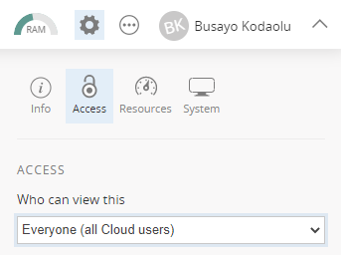
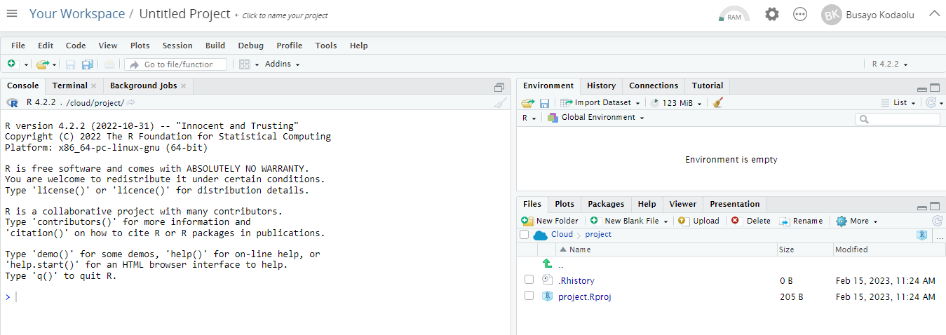
Welcome Back!
Session 1
Session 2
Session 3
Session 4
Wrap-up!
Click here
Brings you to RStudio IDE like the RStudio Desktop

Slide 16
Introduction to R and RStudio
Welcome Back!
Session 1
Session 2
Session 3
Session 4
Wrap-up!

Slide 17
R Programming Language
Welcome Back!
Session 1
Session 2
Session 3
Session 4
Wrap-up!
R, developed by Ross Ihaka and Robert Gentleman at the University of Auckland, New Zealand in the mid-1990s, is a programming language for mostly statistical computing and graphics.
IEEE publishes a list of the most popular programming languages each year. R was ranked 5th in 2016, up from 6th in 2015. Due to its expressive syntax and easy-to-use interface, it has grown in popularity in recent years.
R provides tools and techniques for
Linear and nonlinear modeling
Time-series analysis
Classification and Clustering
Graphical Representation of data
etc.
Adapted from: https://www.datamentor.io/r-programming

Slide 18
Why R Language?
Welcome Back!
Session 1
Session 2
Session 3
Session 4
Wrap-up!
Why R?
R is open-source and free
R runs on all platforms (Windows, Linux and Mac)
R has lots of packages
R language has more than 10,000 packages stored in the CRAN repository, and the number is continuously increasing.
R facilitates quality plotting and graphing.
The popular libraries like ggplot2 and plotly are used for visually appealing graphs that makes R outstanding from other programming languages.
R is Highly Compatible
R can be paired with many other programming languages like C, C++, Java, and Python.
Adapted from: https://www.simplilearn.com/what-is-r-article

Slide 19

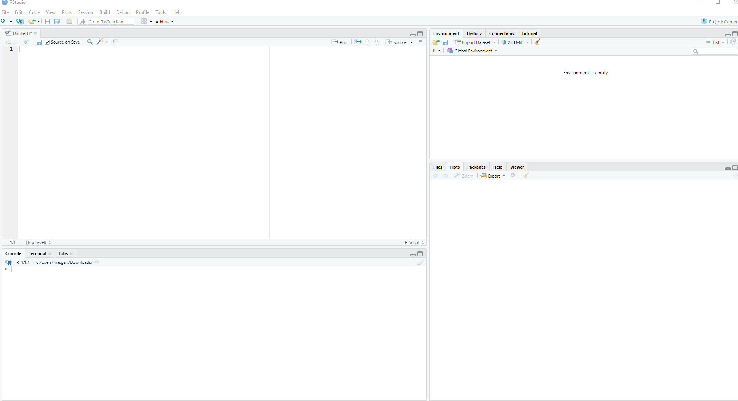
What is RStudio?
Welcome Back!
Session 1
Session 2
Session 3
Session 4
Wrap-up!
RStudio is a free and open-source Integrated Development Environment (IDE) for R
RStudio is available in two editions:
RStudio Desktop: the program is run locally as a regular desktop application;
RStudio Server: allows accessing RStudio using a web browser while it is running on a remote Linux server.
Environment/History
Syntax-highlighting editor
Files/Plots/Packages/
Help
Console
Adapted from: https://www.r-project.org

Slide 20
RStudio Projects
Welcome Back!
Session 1
Session 2
Session 3
Session 4
Wrap-up!
Creating a project in RStudio is a good practice for several reasons:
Organization: By creating a project, you can keep all your R scripts, R markdown documents, R functions and data together in one place. This makes it easier to keep track of your progress, collaborate with others, and share your work.
Isolation: R projects are self-contained. It means the libraries, packages, and environment variables that you use in one project will not interfere with other projects.
Reproducibility: Projects in RStudio allow you to save your workspace and the state of your environment, so that you can easily reproduce your analysis later.
All in all, creating a project in RStudio provides a streamlined workflow that helps you stay organized, focused, and productive while working on your data analysis projects.
Adapted from: https://intro2r.com

Slide 21
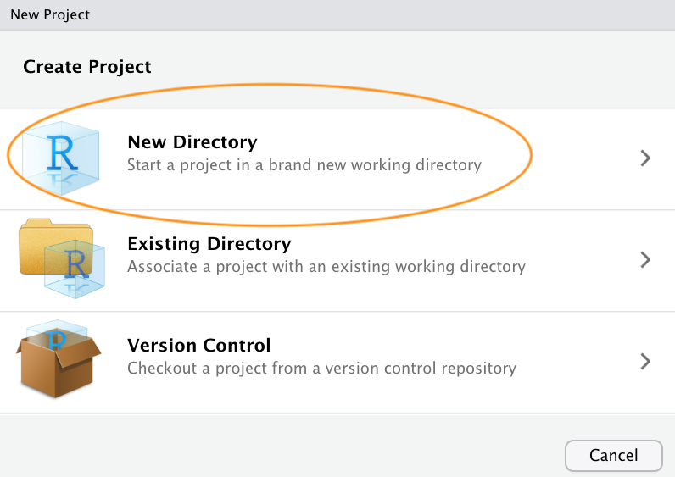
RStudio Projects
Welcome Back!
Session 1
Session 2
Session 3
Session 4
Wrap-up!
How to create an RStudio Project?
Open RStudio and click on "File" from the top menu bar, then click "New Project".
In the "New Project" window, select the type of project you want to create. You can choose from a variety of project types, such as "New Directory", "Existing Directory", "Version Control", or "Package".
Adapted from: https://intro2r.com

Slide 22
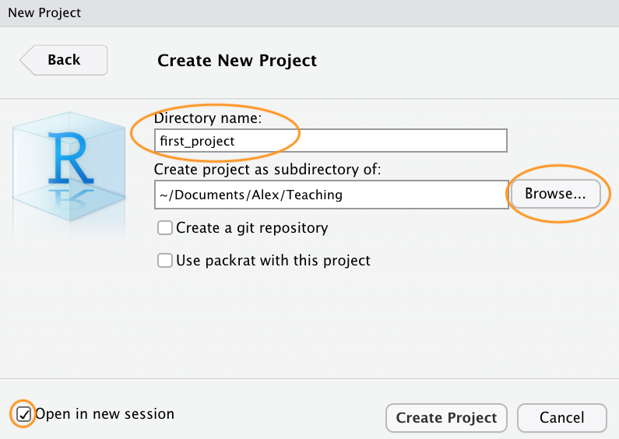
RStudio Projects
Welcome Back!
Session 1
Session 2
Session 3
Session 4
Wrap-up!
How to create an RStudio Project?
Next, you'll need to specify the project directory and location. Choose a name for your project and select the directory where you want to save your project files. You can create a new directory or choose an existing one.
Adapted from: https://intro2r.com

Slide 23
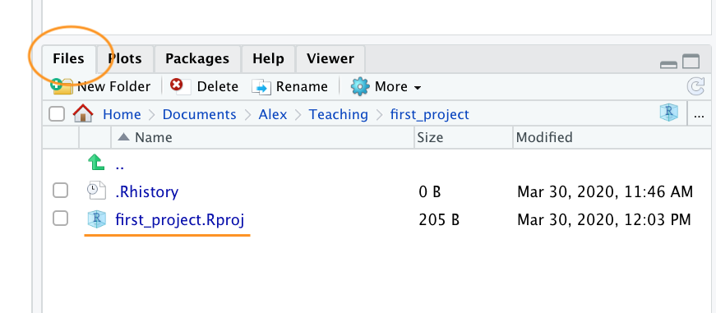
RStudio Projects
Welcome Back!
Session 1
Session 2
Session 3
Session 4
Wrap-up!
How to create an RStudio Project?
Now, you have a new folder on your computer containing an RStudio project file called first_project.Rproj. This .Rproj file contains various project options and can also be used as a shortcut for opening the project directly from the file system (just double click on it).
You can check this out in the ‘Files’ tab in RStudio.
Adapted from: https://intro2r.com

Slide 24
RStudio Projects
Welcome Back!
Session 1
Session 2
Session 3
Session 4
Wrap-up!
How to create an RStudio Project?
Once your project is created, you can start coding by opening a new R script file or opening an existing R script file.
You can also use RStudio's other features, such as the console, the environment tab, and the plot tab, to analyze and visualize your data.
Adapted from: https://intro2r.com

Slide 25
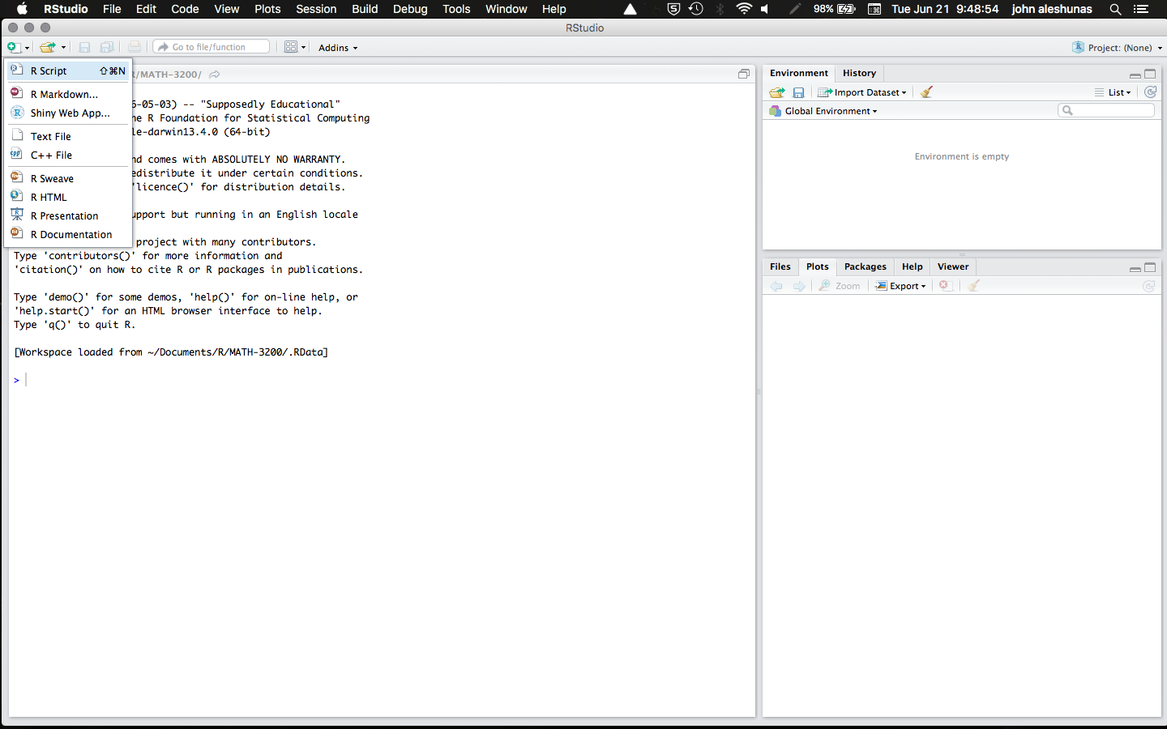
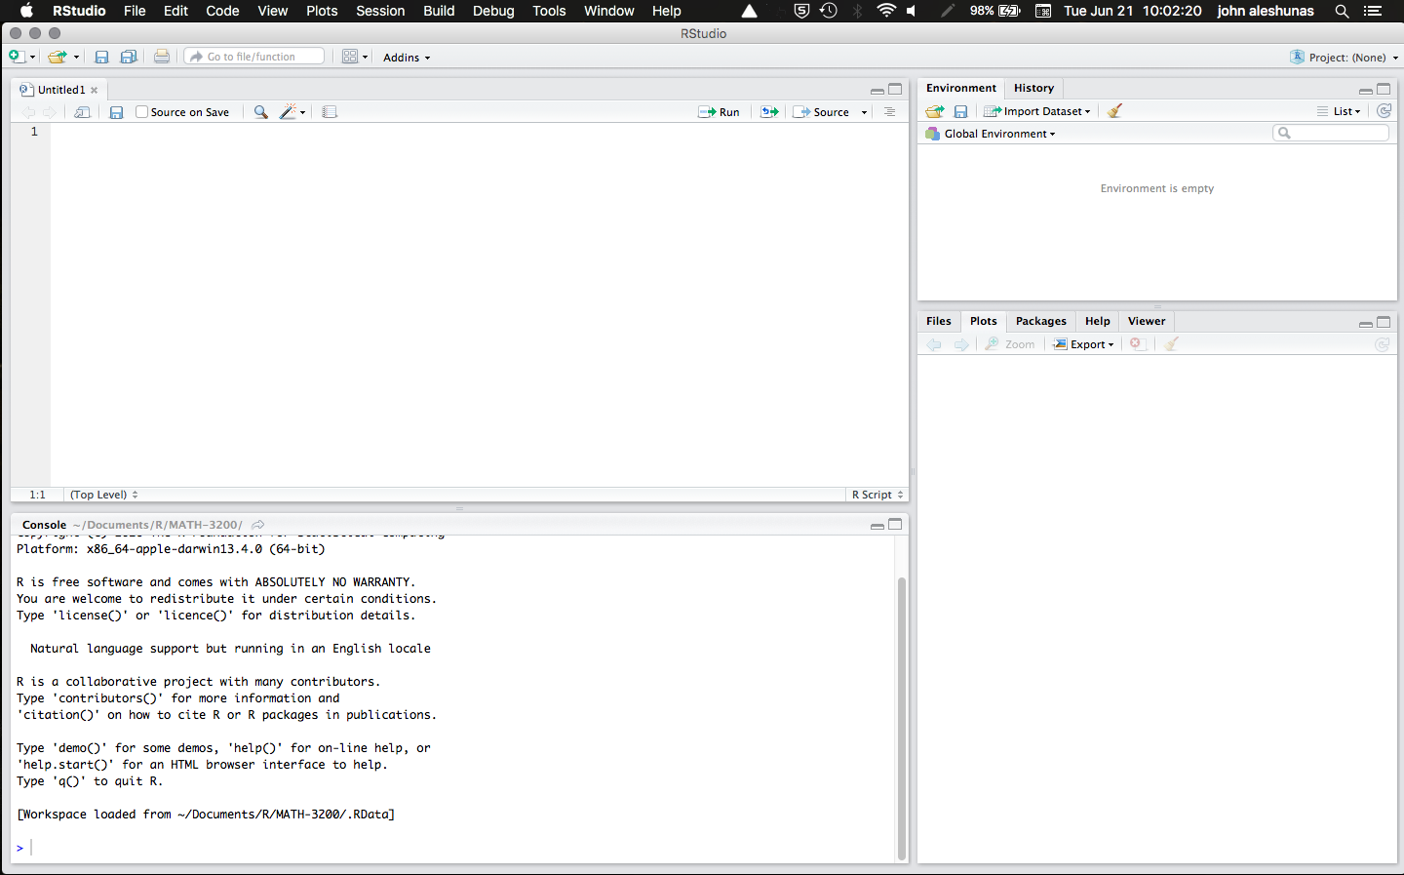
R Scripts
Welcome Back!
Session 1
Session 2
Session 3
Session 4
Wrap-up!
Creating, opening, and running R scripts are important tasks in R programming.
Creating a new R script:
In RStudio, click on "File" from the top menu bar and select "New File".
From the dropdown menu, select "R Script" and click "OK".
A new blank R script will appear in the editor window. You can start writing your code in this file
Adapted from: https://rforhr.com/g

Slide 26
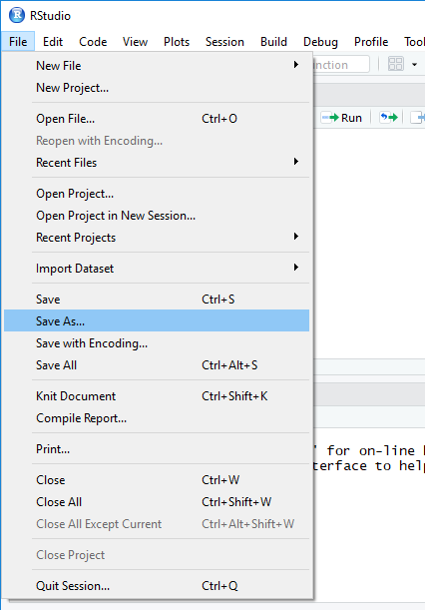
R Scripts
Welcome Back!
Session 1
Session 2
Session 3
Session 4
Wrap-up!
Creating a new R script:
If you want to save the changes you made to an existing R script, simply click on "File" from the top menu bar and select "Save".
Adapted from: https://rforhr.com/g

Slide 27
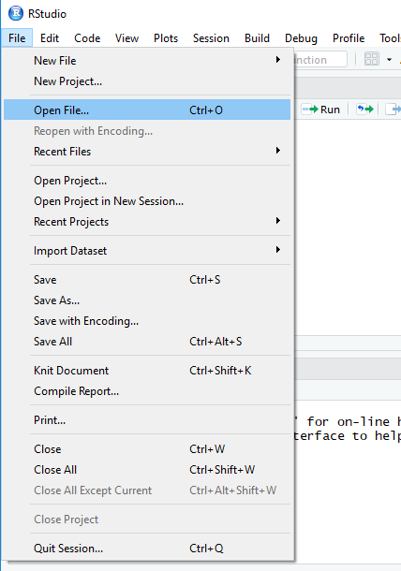
R Scripts
Welcome Back!
Session 1
Session 2
Session 3
Session 4
Wrap-up!
Opening an existing R script:
In RStudio, click on "File" from the top menu bar and select "Open File".
Navigate to the location of the R script on your computer and select it.
The R script will open in a new tab in the editor window, and you can start working with the code.
Adapted from: https://intro2r.com

Slide 28
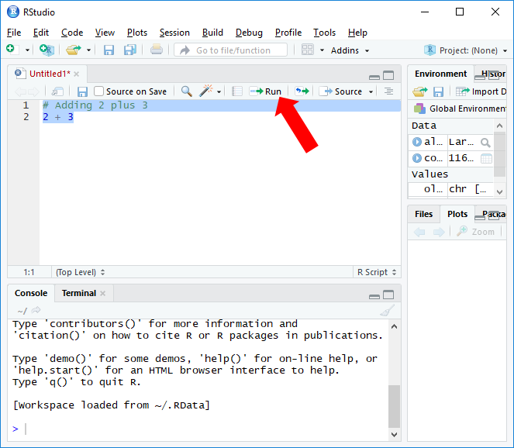
R Scripts
Welcome Back!
Session 1
Session 2
Session 3
Session 4
Wrap-up!
Running an R script:
In the editor window of RStudio, select the code you want to run.
Click on the "Run" button located in the top-right corner of the editor window.
The output of your code will appear in the console window at the bottom
of the screen.
Adapted from: https://intro2r.com

Slide 29
Navigating the tree of directory
Welcome Back!
Session 1
Session 2
Session 3
Session 4
Wrap-up!
Get the path of the current directory with getwd() (get working directory)
getwd()
Change working directory with setwd() (set working directory)
setwd("~/Rcourse")
Adapted from: https://intro2r.com

Slide 30
Variables in Programming
Welcome Back!
Session 1
Session 2
Session 3
Session 4
Wrap-up!
In programming languages, a Variable is a named location in memory that can hold a value.
Variables are used to store data that can be manipulated and processed by the program.
Variables are defined using a Name and a Data Type.
The name of the variable is used to refer to the data stored in the memory location, and the data type specifies the type of data that can be stored in the variable.
Variables can be assigned a value using an assignment operator (=) (and/or (<-) (leftward) in R programming language).
For example, in R programming, you can define a variable named "x" to hold a numeric value using the following syntax:
x <- 10 or x = 10
Adapted from: https://www.geeksforgeeks.org/r-variables/

Slide 31
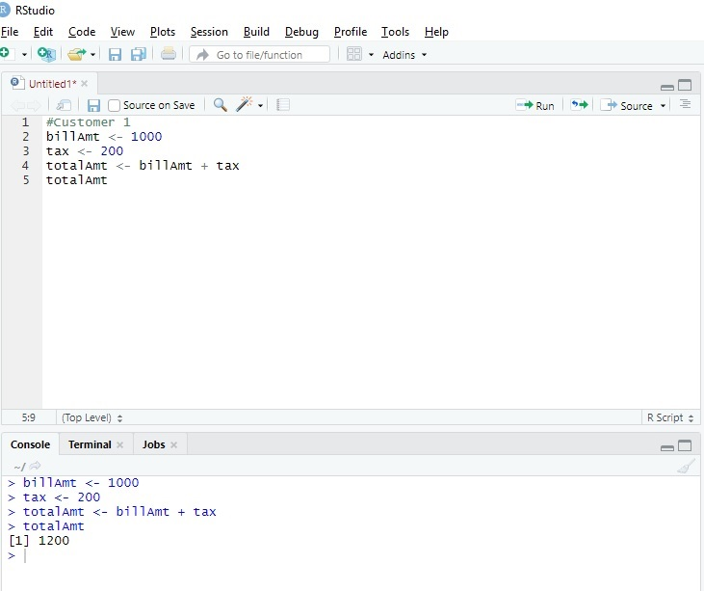
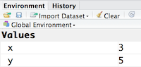
Variables in Programming
Welcome Back!
Session 1
Session 2
Session 3
Session 4
Wrap-up!
Variables can be used in a program to
Store Input Data
Perform various operations, such as arithmetic, comparison, and logical operations.
Store the results of a computation or to pass data between functions or modules within the program.
You can also view information on the variable by looking in your Environment window in the upper right-hand corner of the RStudio interface.
Adapted from: https://biocorecrg.github.io/CRG_RIntroduction/

Slide 32
Variables in Programming
Welcome Back!
Session 1
Session 2
Session 3
Session 4
Wrap-up!
Tips on Variable Names
Make your names explicit and not too long
Avoid names starting with a number (2x is not valid, but x2 is)
Avoid names of fundamental functions in R (e.g., if, else, for). When in doubt check the help to see if the name is already in use
Avoid dots (.) within a variable name as in my.dataset
Use nouns for object names
Keep in mind that R is case sensitive
Adapted from: https://github.com/hbctraining/

Slide 33
Basic Data Types
Welcome Back!
Session 1
Session 2
Session 3
Session 4
Wrap-up!
R supports various data types. Some of the basic data types in R are:
1. Numeric: This data type represents numeric values, including integers and real numbers.
Numeric values can be positive, negative, or zero
They are represented as double precision floating-point values by default.
2. Character: This data type represents textual data, such as names, sentences, and paragraphs. In R, character values are enclosed in quotes, either single ('') or double ("").
3. Logical: This data type represents Boolean values, which are either TRUE or FALSE.
Adapted from: https://www.geeksforgeeks.org/r-data-types/

Slide 34
Programming Operators
Welcome Back!
Session 1
Session 2
Session 3
Session 4
Wrap-up!
Operators are used for operations on data. We have Arithmetic, Comparison, Logical, and Assignment operations.
Arithmetic Operators: These are used to perform Mathematical Calculations on numeric values.
+ Addition → X <- 2+2
- Subtraction → X <- 2-2
* Multiplication → X <- 2*2
/ Division → X <- 2/2
^ Exponentiation → X <- 2^2
%% Remainder after division → X <- 2%%2
Adapted from: https://www.w3schools.com/r/

Slide 35
Programming Operators
Welcome Back!
Session 1
Session 2
Session 3
Session 4
Wrap-up!
Operators are used for operations on data. We have Arithmetic, Comparison, Logical, and Assignment operations.
Comparison Operators: These are used to compare two values and return a logical value (TRUE or FALSE).
< Less than → 2<3 return: TRUE
> Greater than → 2>3 return: FALSE
<= Less than or equal to → 2<=3 return: TRUE
>= Greater than or equal to → 2>=3 return: TRUE
== Equal to → 2==3 return: FALSE
!= Not equal to → 2!=3 return: TRUE
Adapted from: https://www.w3schools.com/r/

Slide 36
Programming Operators
Welcome Back!
Session 1
Session 2
Session 3
Session 4
Wrap-up!
Operators are used for operations on data. We have Arithmetic, Comparison, Logical, and Assignment operations.
Logical Operators: These are used to combine or negate logical values.
& Element-wise logical AND → (X > 30 & Y<15 )
| Element-wise logical OR → (X > 30 | Y<15 )
! Element-wise logical NOT
& Short-circuiting logical AND
|| Short-circuiting logical OR
Adapted from: https://www.w3schools.com/r/

Slide 37
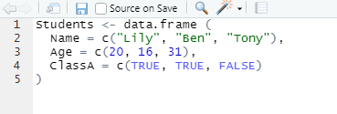
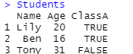
DataFrames in R
Welcome Back!
Session 1
Session 2
Session 3
Session 4
Wrap-up!
In R, a data frame is a two-dimensional object for storing data tables in rows and columns. The columns should have the same size, but they can store different data types.
A data frame in R can be created using the data.frame() function. For example, to create a data frame with three columns, “Name“, “Age", and “ClassA”, we can use the following code:
c() function: Creates a vector of objects with the same datatypes.
All columns have the same length.
The name of data frame is “Students”.
Students have columns with Numeric, character and logical datatypes.
Adapted fromhttps://www.w3schools.com/r

Slide 38
DataFrames in R
Welcome Back!
Session 1
Session 2
Session 3
Session 4
Wrap-up!
You can access the elements of a data frame using the $ operator or the square bracket [] operator.
For example, to access “Name” column of the “Students” data frame we can use the following code:
Students $Name
To access the second row of the “Students” data frame , we can use the following code:
Students[2, ]
You can also use logical operators to select specific rows or columns based on a condition. For example, to select all rows where the Age is greater than 15, you can use the following code:
Students[Students$Age > 15, ]
Get first rows of a DataFrame: head() → head(Students)
Get last rows of a DataFrame: tail() → tail(Students)
Adapted fromhttps://www.w3schools.com/r

Slide 39
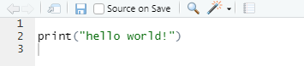
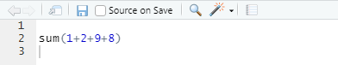
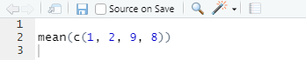
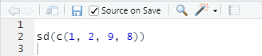
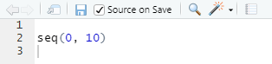
Basic Built-in Functions in R
Welcome Back!
Session 1
Session 2
Session 3
Session 4
Wrap-up!
Some basic Functions in R:
print() - Prints the specified input to the console.
sum() - Returns the sum of numeric data.
mean() - Returns the mean of a numeric vector.
sd() - Returns the standard deviation of a numeric vector.
seq() - Generates a sequence of numbers.
Adapted fromhttps://www.w3schools.com/r

Slide 40
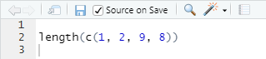
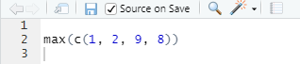
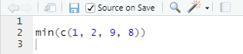
Basic Built-in Functions in R
Welcome Back!
Session 1
Session 2
Session 3
Session 4
Wrap-up!
Some basic Functions in R:
length() - Returns the length of a vector.
max() - Returns the maximum value of a vector.
min() - Returns the minimum value of a vector.
Adapted fromhttps://www.w3schools.com/r

Slide 41
Calling Functions in R
Welcome Back!
Session 1
Session 2
Session 3
Session 4
Wrap-up!
Built-in functions: In R, you can call a function by typing the name of the function followed by parentheses containing any necessary arguments.
Functions in Packages
1 - Explicitly loading the package:
In R, you can call a function from a package by first loading the package into your R session using the library() or require() functions, and then calling the function using the function name.
library(ggplot2)
MyGraph <- ggplot(....)
Adapted fromhttps://www.w3schools.com/r

Slide 42
Calling Functions in R
Welcome Back!
Session 1
Session 2
Session 3
Session 4
Wrap-up!
Built-in functions: In R, you can call a function by typing the name of the function followed by parentheses containing any necessary arguments.
Functions in Packages
2 - Without loading the package:
In R, you can call a function from a package without explicitly loading the package by using the double colon operator ::
The double colon operator allows you to access functions and objects in a package without loading the entire package into the current R session.
MyGraph <- ggplot2::ggplot(....)
Adapted fromhttps://www.w3schools.com/r

Slide 43
Commenting in R
Welcome Back!
Session 1
Session 2
Session 3
Session 4
Wrap-up!
Comments are generic English sentences, mostly written in a program to explain what it does or what a piece of code is supposed to do. More specifically, information that programmer should be concerned with, and it has nothing to do with the logic of the code. They are completely ignored by the compiler and are thus never reflected on to the input.
Comments are generally used for the following purposes:
Code Readability
Explanation of the code or Metadata of the project
Prevent execution of code
To include resources
Adapted fromhttps://www.w3schools.com/r

Slide 44
Commenting in R
Welcome Back!
Session 1
Session 2
Session 3
Session 4
Wrap-up!
There are two types of comments in R: single-line comments and multi-line comments.
Single-line comments start with the # symbol and continue until the end of the line.
# This is a single-line comment
Multi-line comments are enclosed in /* */ symbols. For example:
/*
This is a multi-line comment
It can span across multiple lines
*/
It is good practice to include comments in your code to make it easier to understand and maintain. It is also important to keep your comments up to date as you make changes to your code.
Adapted fromhttps://www.w3schools.com/r

Slide 45
Some RStudio Useful Shortcuts
Welcome Back!
Session 1
Session 2
Session 3
Session 4
Wrap-up!
Description | Windows & Linux | Mac
Clear console | Ctrl+L | Ctrl+L
Change working directory | Ctrl+Shift+H | Ctrl+Shift+H
Save all documents | Ctrl+Alt+S | Cmd+Option+S
Undo | Ctrl+Z | Cmd+Z
Redo | Ctrl+Shift+Z | Cmd+Shift+Z
Indent | Tab (at beginning of line) | Tab (at beginning of line)
Outdent | Shift+Tab | Shift+Tab
Search R Help | Ctrl+Alt+F1 | Ctrl+Option+F1
Save RScripts | Ctrl+S | Cmd+S
Comment/uncomment a Line | Ctrl+Shift+C | Cmd+Shift+C
Run Codes | Ctrl+Enter | Cmd+Enter
Adapted from: https://support.posit.co/

Slide 46

Welcome Back!
Session 1
Session 2
Session 3
Session 4
Wrap-up!
Coffee Break!

